Slide 1

PROVERB & RIDDLE
Arranged by
Rizaky Okta Ramadiansyah

Slide 2

Proverb
PROVERB is a verse or collection of words that are in a fixed structure, containing certain meanings that contain positive suggestions.
Kinds of Proverbs :
1. Aphorism
This proverb offers advice.
2. Parable
That has a moral lesson and has parable
3. Slogan
This proverb gives spirit or motivation
4. Idiom
Idiom is a group of words arranged by a certain arrangement in which the meaning cannot be guessed from the meanings of the constituent words separately.

Slide 3


Proverb
Ex.
1.
2.
Better Late Then Never It's best to do something on time. But if you can't do it on time, do it late.
You Can’t Judge a Book by It’S Cover Things sometimes look different than they really are. A restaurant that looks old and small might have amazing food, for example.

Slide 4
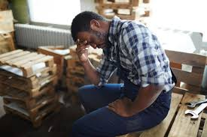

Proverb
3.
4.
No Man is an Island You can't live completely independently. Everyone needs help from other people.
One Man’s Trash Is Another Man’s Treasure Different people have different ideas about what's valuable.

Slide 5

Proverb
5.
There’s No Place Like Home Your own home is the most comfortable place to be.

Slide 6

Riddle
RIDDLE is a type of poem that describes something without actually naming what it is, leaving the reader to guess.
Puzzles can be anything, from puzzles about animals to about objects. There are no rules about how the structure of a puzzle poem, puzzles can be funny or can rhyme, it depends on the person who wrote the puzzle.

Slide 7

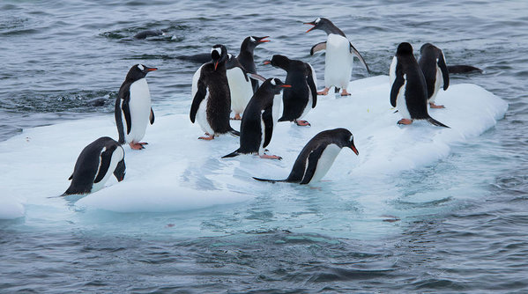
Riddle
Ex.
1.
2.
R : It cannot be touched and cannot be held, but is easy to destroy. What is it? A : It’s a Promise and trust.
R : I can't burn and can't sink, am I? A : I’m Ice Cube.

Slide 8
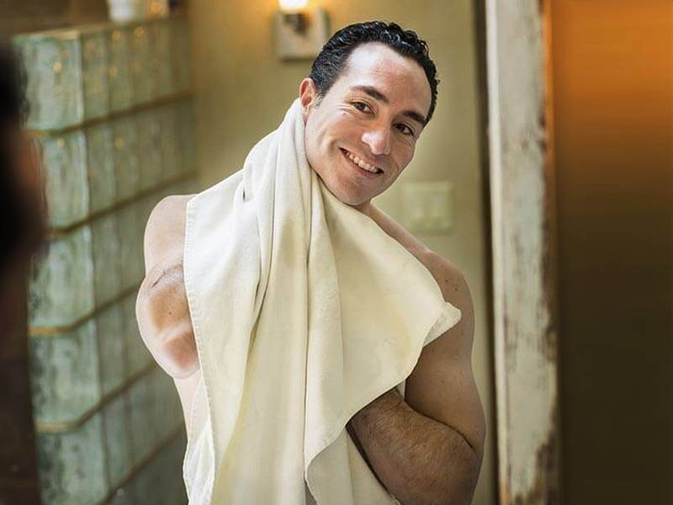
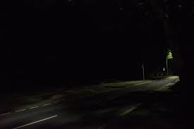
Riddle
3.
4.
R : What gets wetter, the more it dries? A : A towel.
R : The more there is, the less you see. A : Darkness.

Slide 9
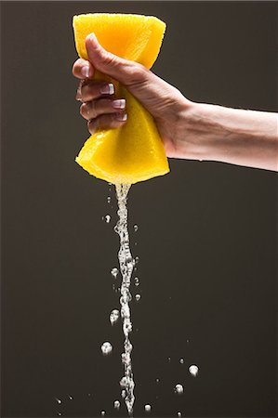
Riddle
5.
R : What’s full of holes but still holds water? A : A sponge.

Slide 10

THANK YOU ☺

